Slide 1

VELAMMAL COLLEGE OF ENGINEERING AND TECHNOLOGY
DEPARTMENT OF ELECTRONICS AND COMMUNICATION ENGINEERING
MINI PROJECT EXPO
PROJECT NAME : FIRE FIGHTING ROBOT

Slide 2
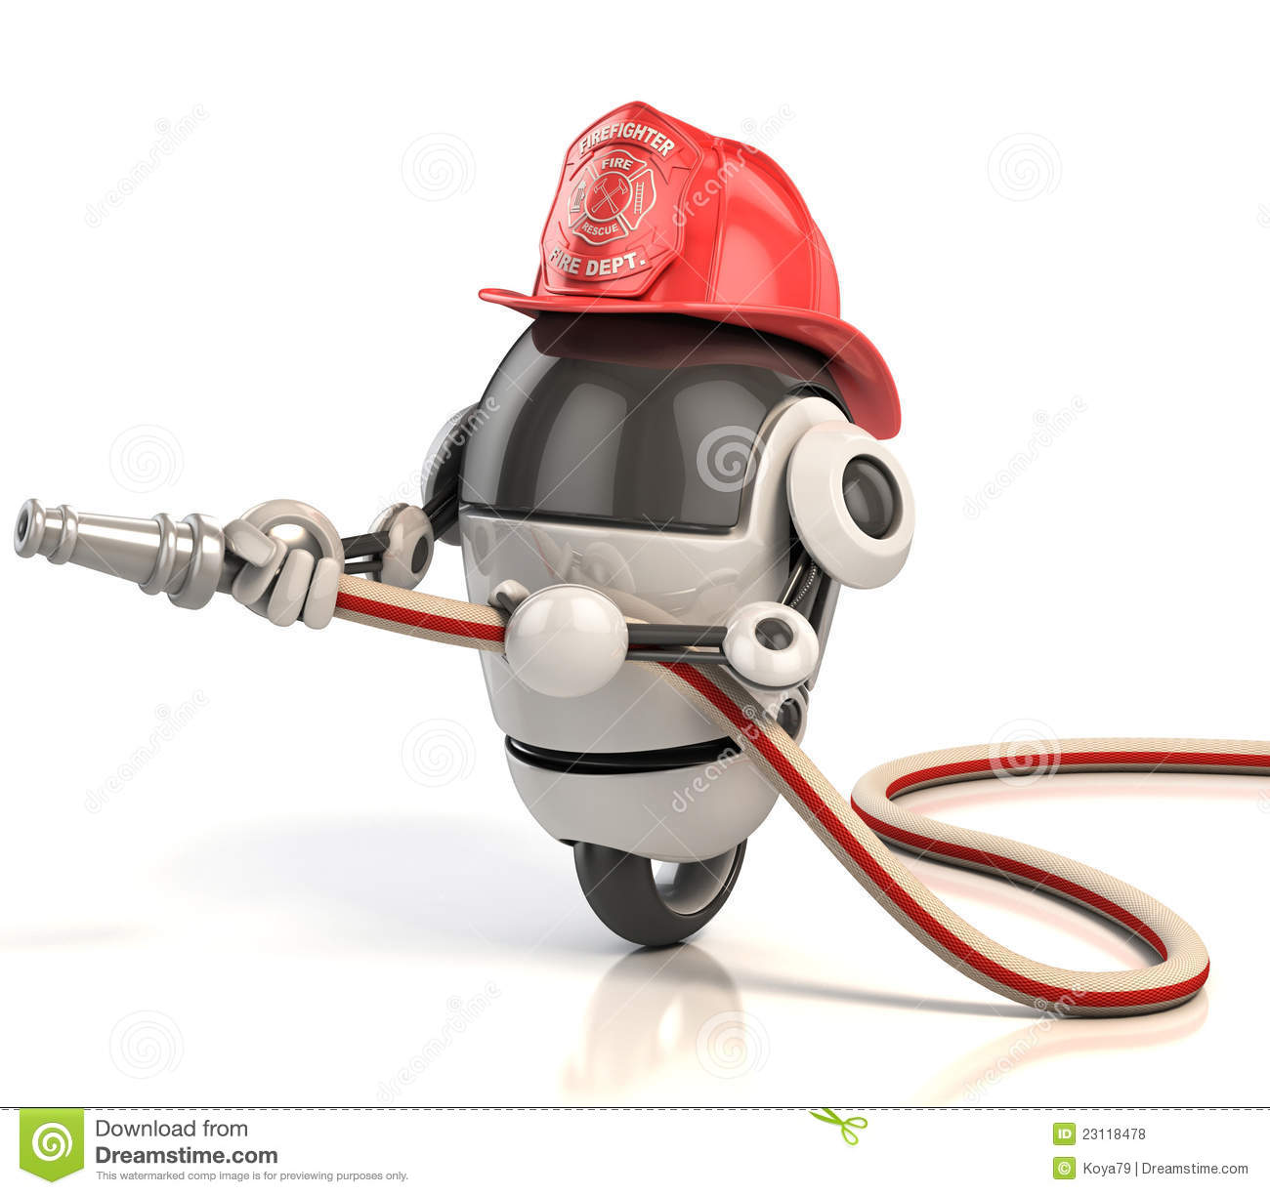
What is fire fightING robot?
The Robot has been developed with features to move in the direction with respect to the fire intensity.
The 5V water pump is used to pump out water around the fire and put down the fire with the help of flame sensor and Arduino UNO.

Slide 3
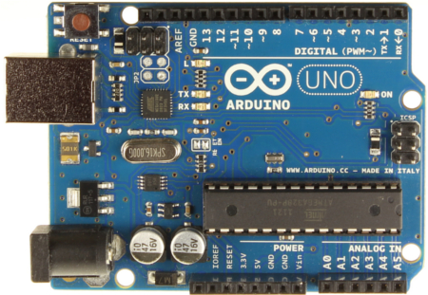
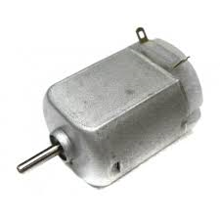
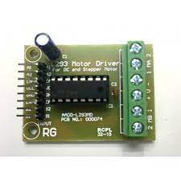
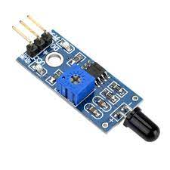
ComponentS
ARDUINO UNO
DC MOTOR
L293D – MOTOR DRIVER
FLAME SENSOR

Slide 4
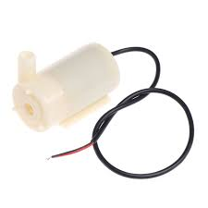
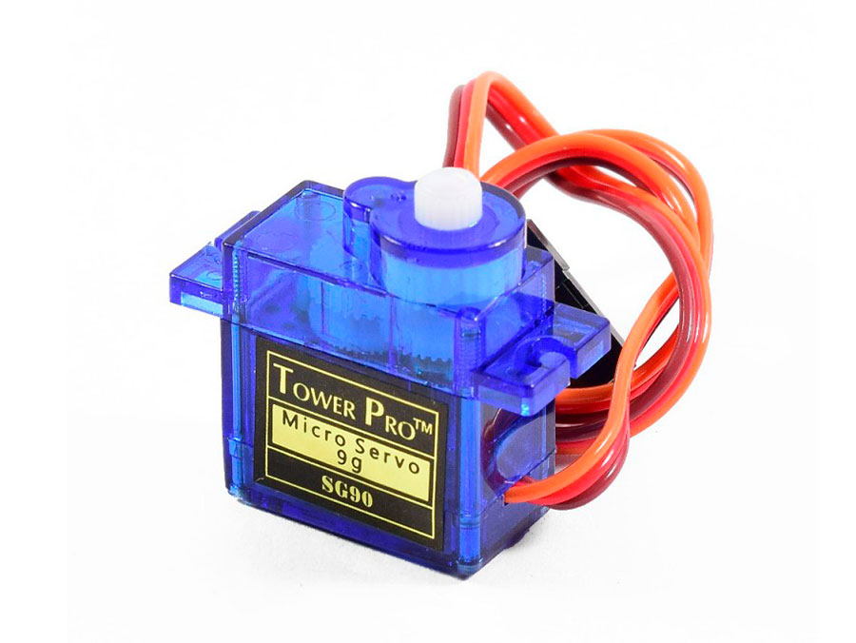
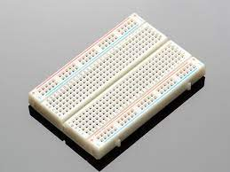
CONT’s
5V WATER PUMP
SERVO MOTOR
BREAD BOARD

Slide 5
FLOW OF WORKING
Movement step
Flame tracking step
Fire Extinguishing step

Slide 6
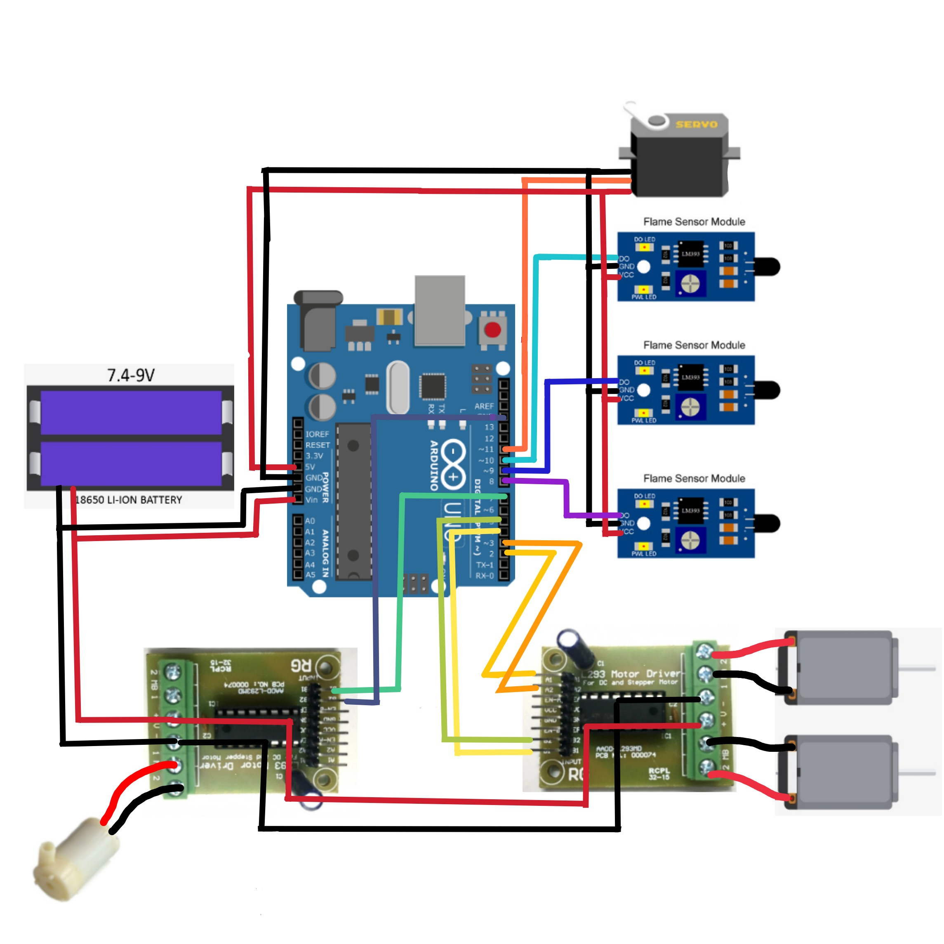
THE SCHEMATIC DIAGRAM

Slide 7

APPLICATION
This product can be used in:
Hazardous materials storage facilities
Mass transit systems
Data centers and server rooms
The pharmaceutical industry

Slide 8
SCOPE OF THIS PRODUCT
INDIA is trying to take the position of developed country for that India has to be completely digitalized. In many developed countries even though they are fully automized there may occur some fire accidents with the help of this we can avoid such situation. This robot also have a large scope in World Markets.

Slide 9
RELEVANCE
11037 Fire accident were occurred in the year 2019 at INDIA .
Over 70℅ are occurred in industries, IT companies and educational institutions.
It can be avoided by using this robot. It ensures the safety of this Society.

Slide 10
OUR FUTURE DEVELOPMENT IN THIS PRODUCT
In future we will implement automatic water refilling methodology to this robot.
We will also build a GPS Location sharing system which will send the alert message with GPS location to the Fire and rescue department.
We will further set a display to show level of intensity of fire and the temperature.

Slide 11


